Slide 1
DEPARTMENT OF PERIODONTOLOGY FINAL YEAR BDS
RUNGTA COLLEGE OF DENTAL SCIENCES AND RESEARCH
THE PERIODONTAL FLAP
PRESENTED BY:
Dr. Aena Jain Pundir
Professor
Dept. of Periodontology

Slide 2
Specific Learning Objectives
Core areas | Domain | Category
Introduction | Affective | Desire to know
Classification | Cognitive | Nice to know
Incisions | Psychomotor | Must know
Flap techniques for pocket therapy | Psychomotor | Must know

Slide 3
Contents
Introduction
Classification
Incisions
Flap techniques for pocket therapy
Conclusion
references

Slide 4
A periodontal flap is a section of gingiva and/or mucosa surgically separated from the underlying tissues to provide visibility of and access to the bone and root surface.
Periodontal flaps can be classified based on the following:
I. Bone exposure after flap reflection.
II. Placement of flap after surgery.
III. Management of the papilla.

Slide 5
I. BASED ON BONE EXPOSURE AFTER REFLECTION:
A. Full thickness flaps : also known as mucoperiosteal flap.
All the soft tissue including periosteum is reflected to expose underlying bone.
Indicated when resective osseous surgery is comtemplated.
B. Partial thickness flaps : also called as split thickness flap.
Includes epithelium and a underlying layer of connective tissue.
Bone remains covered by a layer of connective tissue including periosteum.
Indicated when bone exposure is not required or flap is to be ositioned apically.

Slide 6
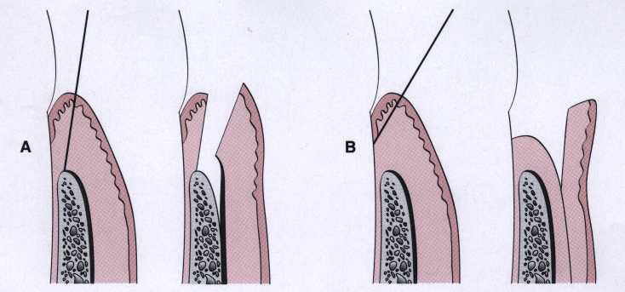
Full thickness flap Partial thickness flap

Slide 7
II. BASED ON FLAP PLACEMENT AFTER SURGERY:
Nondisplaced flaps: when flap is returned and sutured in its original position.
Displaced flaps: which are placed apically, coronally or laterally to their original position.

Slide 8
III. BASED ON THE MANAGEMENT OF PAPILLA:
A. CONVENTIONAL FLAP: interdental papilla is split beneath the contact point of the two approximating teeth to allow reflection of the buccal and lingual flaps.
Indicated when interdental spaces are too narrow and when flap is to be displaced apically.
B. PAPILLA PRESERVATION FLAP: incorporates the entire papilla in one of the flaps.
Indicated when wide interdental space is present.

Slide 9
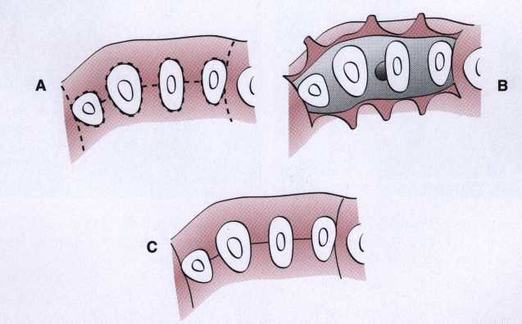
Conventional or traditional flap technique

Slide 10
INCISIONS
HORIZONTAL
VERTICAL
Horizontal incisions are directed along the margin of the gingiva in a mesial or distal direction.
Vertical used on one or both ends of the horizontal incision.
Internal bevel incision
Crevicular incision
Interdental incision

Slide 11
INTERNAL BEVEL INCISION
It is basic incision to most periodontal flap procedures, starts at a distance from gingival margin and is aimed at the bone crest.
It is the incision from which the flap is reflected to expose underlying bone and root.
It is termed as First Incision because it is the intial incision in reflection of periodontal flap.
It is also termed as Reverse Bevel Incision because its bevel is in reverse direction from gingivectomy incision.

Slide 12
It produces a sharp, thin flap margin for adaptation to bone tooth junction.
OBJECTIVES OF INTERNAL BEVEL INCISION:
It removes pocket lining.
It conserves relatively uninvolved outer surface of gingiva, which if apically positioned becomes attached gingival.
It produces a sharp, thin flap margin for adaptation to the bone-tooth junction.
INSTRUMENTS USED: #15 or #15C surgical blade is used.

Slide 13
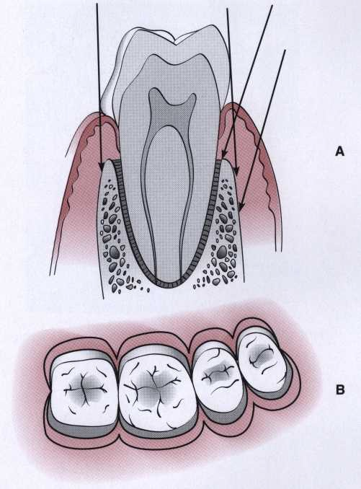
It starts from a designated area on gingiva and is directed to an area at or near the crest of bone.
The starting point is determined by whether the flap is to be displaced apically (by stepping back from margin and scalloping the flap) or not.
The internal bevel (first) incision can be made at varying locations and angles according to the different anatomic and pocket situations.

Slide 14
CREVICULAR INCISION
Also known as Second Incision.
It is made from the base of the pocket to the crest of bone.
This incision together with initial reverse bevel incision forms a V-shaped wedge ending at or near the crest of bone.
This wedge of tissue contains most of inflamed and granulomatous area which constitute lateral wall of pocket and as well as the junctional epithelium and connective tissue fibers.
The incision is carried out with beak shaped #12D blade.

Slide 15
INTERDENTAL INCISION
Also known as THIRD INCISION
It is given to separate the collar of gingiva left around the tooth.
It is made not only on facial or lingual surface but also interdentally to free gingiva completely around the tooth.
Orban knife is used for this incision.

Slide 16
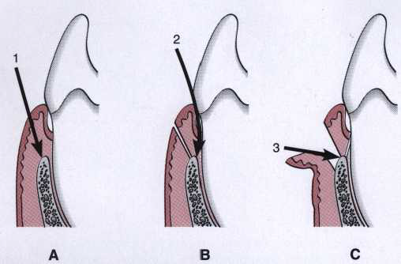
The first (internal bevel), second (crevicular), and third (interdental) incisions are the three incisions necessary for flap surgery

Slide 17
THE FLAP TECHNIQUE FOR POCKET THERAPY

Slide 18
FLAPS ARE USED FOR POCKET THERAPY TO ACCOMPLISH THE FOLLOWING:
1. Increase accessibility to root deposits.
2. Eliminate or reduce pocket depth by resection of the pocket wall.
3. Expose the area to perform regenerative methods.

Slide 19
Techniques for Access and Pocket Depth Reduction/Elimination
The Modified Widman flap facilitates instrumentation but does not attempt to reduce pocket depth.
The reduction or elimination of pocket depth is the main purpose of two flap techniques:
UNDISPLACED FLAP
APICALLY DISPLACED FLAP

Slide 20
MODIFIED WIDMAN FLAP

Slide 21
Step 1: The initial incision is an internal bevel incision to the alveolar crest starting 0.5 to 1 mm away from the gingival margin. Scalloping follows the gingival margin.
Step 2: The gingiva is reflected with a periosteal elevator.
Step 3: A crevicular incision is made from the bottom of the pocket to the bone, circumscribing the triangular wedge of tissue containing the pocket lining.
Step 4: After the flap is reflected, a third incision is made in the interdental spaces coronal to the bone with a curette or an interproximal knife, and the gingival collar is removed.

Slide 22
Step 5: Tissue tags and granulation tissue are removed with a curette. The root surfaces are checked, then scaled and planed if needed.
Step 6: Bone architecture is not corrected except if it prevents good tissue adaptation to the necks of the teeth. Every effort is made to adapt the facial and lingual interproximal tissue adjacent to each other in such a way that no interproximal bone remains exposed at the time of suturing.
Step 7: Interrupted direct sutures are placed in each interdental space and covered with periodontal surgical pack.

Slide 23
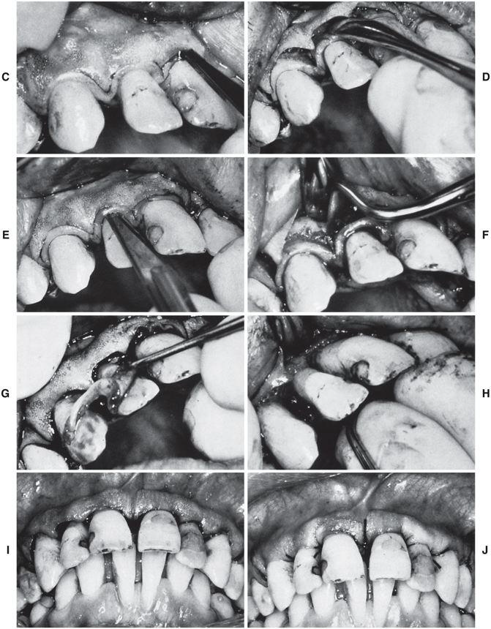

Slide 24
UNDISPLACED FLAP
The undisplaced flap may be the most frequently performed type of periodontal surgery.
The soft tissue pocket wall is removed with the initial incision; thus it may be considered an “INTERNAL BEVEL GINGIVECTOMY.”
To perform this technique without creating a mucogingival problem, the clinician should determine that enough attached gingiva will remain after removal of the pocket wall.

Slide 25
Step 1: The pockets are measured with the periodontal probe, and a bleeding point is produced on the outer surface of the gingiva to mark the pocket bottom.
Step 2: The initial or internal bevel incision is made after the scalloping of the bleeding marks on the gingiva. The incision is usually carried to a point apical to the alveolar crest, depending on the thickness of the tissue. The thicker the tissue, the more apical is the ending point of the incision.

Slide 26
Step 3: The second, or crevicular, incision is made from the bottom of the pocket to the bone to detach the connective tissue from the bone.
Step 4: The flap is reflected with a periosteal elevator (blunt dissection) from the internal bevel incision. Usually there is no need for vertical incisions because the flap is not displaced apically.
Step 5: The third, or interdental, incision is made with an interdental knife, separating the connective tissue from the bone.
Step 6: The triangular wedge of tissue created by the three incisions is removed with a curette.

Slide 27
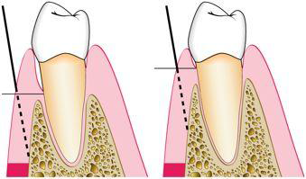
Step 7: The area is debrided, removing all tissue tags and granulation tissue using sharp curettes.
Step 8: After the necessary scaling and root planing, the flap edge should rest on the root-bone junction.
Step 9: A continuous sling suture is used to secure the facial and the lingual or palatal flaps.The area is covered with a periodontal pack.
Diagram showing the location of two different areas where the internal bevel incision is made in an undisplaced flap

Slide 28
APICALLY DISPLACED FLAP
The apically displaced flap technique can be used for
(1) pocket eradication
(2) widening the zone of attached gingiva.
Depending on the purpose, it can be :
FULL-THICKNESS (MUCOPERIOSTEAL) FLAP
SPLIT-THICKNESS (MUCOSAL) FLAP

Slide 29
Step 1: An internal bevel incision is made no more than about 1 mm from the crest of the gingiva and directed to the crest of the bone. The incision is made after the existing scalloping, and there is no need to mark the bottom of the pocket in the external gingival surface because the incision is unrelated to pocket depth.
Step 2: Crevicular incisions are made, followed by initial elevation of the flap; then interdental incisions are performed, and the wedge of tissue that contains the pocket wall is removed.

Slide 30
Step 3: Vertical incisions are made extending beyond the mucogingival junction.
Step 4: After removal of all granulation tissue, scaling and root planing, and osseous surgery if needed, the flap is displaced apically.
Step 5: If a full-thickness flap was performed, a sling suture is given. A partial-thickness flap is sutured to the periosteum using a direct loop suture or a combination of loop and anchor suture. Periodontal pack is given.

Slide 31
PAPILLA PRESERVATION FLAP
The technique for employing a papilla preservation flap is as follows:
Step 1: A crevicular incision is made around each tooth with no incisions across the interdental papilla.
Step 2: The preserved papilla can be incorporated into the facial or lingual/palatal flap, the lingual or palatal incision consists of a semilunar incision across the interdental papilla in its palatal or lingual aspect; this incision dips apically from the line angles of the tooth so that the papillary incision is at least 5 mm from the crest of the papilla.

Slide 32
Step 3: An Orban knife is then introduced into this incision to sever half to two-thirds the base of the interdental papilla. The papilla is then dissected from the lingual or palatal aspect and elevated intact with the facial flap.
Step 4: The flap is reflected without thinning the tissue.

Slide 33
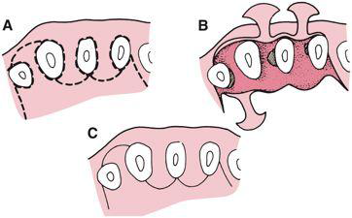
Papilla preservation flap

Slide 34
Summary
Various surgical procedures are being done as treatment of periodontitis. Initial step of any surgery being done is incision and its very crucial to reflect a proper flap as required according to the adviced procedure. All incisions have its advantages and disadvantages. Proper knowledge and skill of a clinician is required for successful treatment.

Slide 35
References
Newman MG, Takei HH, Klokkevold PR, Carranza FA. Carranza’s clinical periodontology, 10th ed. Saunders Elsevier; 2007.
Lindhe J, Lang NP and Karring T. Clinical Periodontology and Implant Dentistry. 6th ed. Oxford (UK): Blackwell Publishing Ltd.; 2015.

